Slide 1

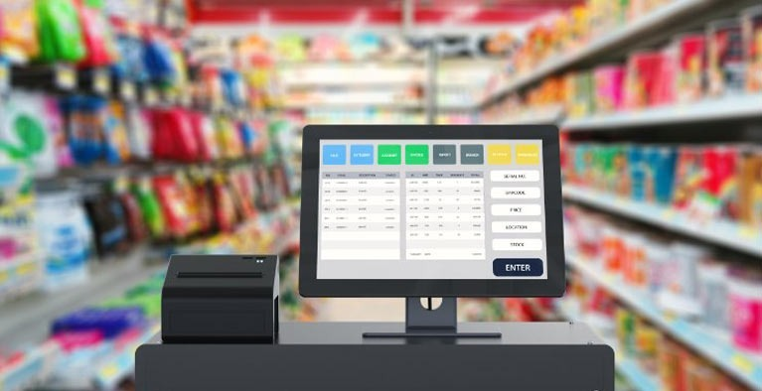
Retail Analytics : Price Optimization Model
By Prajay Urkude

Slide 2


Project Mentors:
Mr. Sharath Manikonda
Director, Innodatatics
https://www.linkedin.com/in/sharat-chandra
C. Gomathi
Mentor
https://www.linkedin.com/in/gomathi-chakravarthy-20a103241/

Slide 3

Contents:
Price optimization Definition
Project Overview and Scope
Project Goals
CRISP-ML(Q) Methodology
Technical Stacks
System Requirements
Project Architecture
Data Collection
Data Understanding and Data Dictionary
Data Pre-Processing
Exploratory Data Analysis
Model Building
Model Deployment
Deployment Output
Challenges
Future Scope

Slide 4
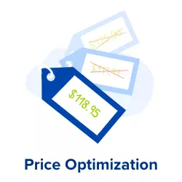
Price Optimization Definition
Price optimization is the process of identifying the optimal price point for any given product at any given location that will yield the highest profit.
The right pricing can make or break a business and copying your competitors might mean starting a price war, but making a guess could leave you balking at abysmal sales numbers.
Hence, successful price optimization is a matter of a balance that can have a major impact on your sales, customer satisfaction, profits, and achievable growth goals.

Slide 5

Project Overview and Scope
The project focuses on predicting an optimized price for a product which will yield maximum profit by increasing the product sale.
This prediction system will help the client to get a suggested price based on the selling cost of a product and the number of products sold.
The project will have a connection between the server where the sales data will be stored and the model will fetch the data to predict the optimized price. The deployment will be using streamlit.
We are building this tool to minimize time and manpower & provide as accurate and thorough results as possible.

Slide 6


Project Goals
Objectives
Constraints
To identify the best price by understanding pricing policy of each product in the retail market based on price optimization.
To maximize the profitability and sales by finding the optimal price of a product.
To minimize churning rate of customers to other vendors.
Quick response to changing market trends.
Price optimization for a product family -
Any changes in the pricing of one product, may trigger a chain reaction across a product family. Hence, the pricing of product family becomes a daunting task.

Slide 7
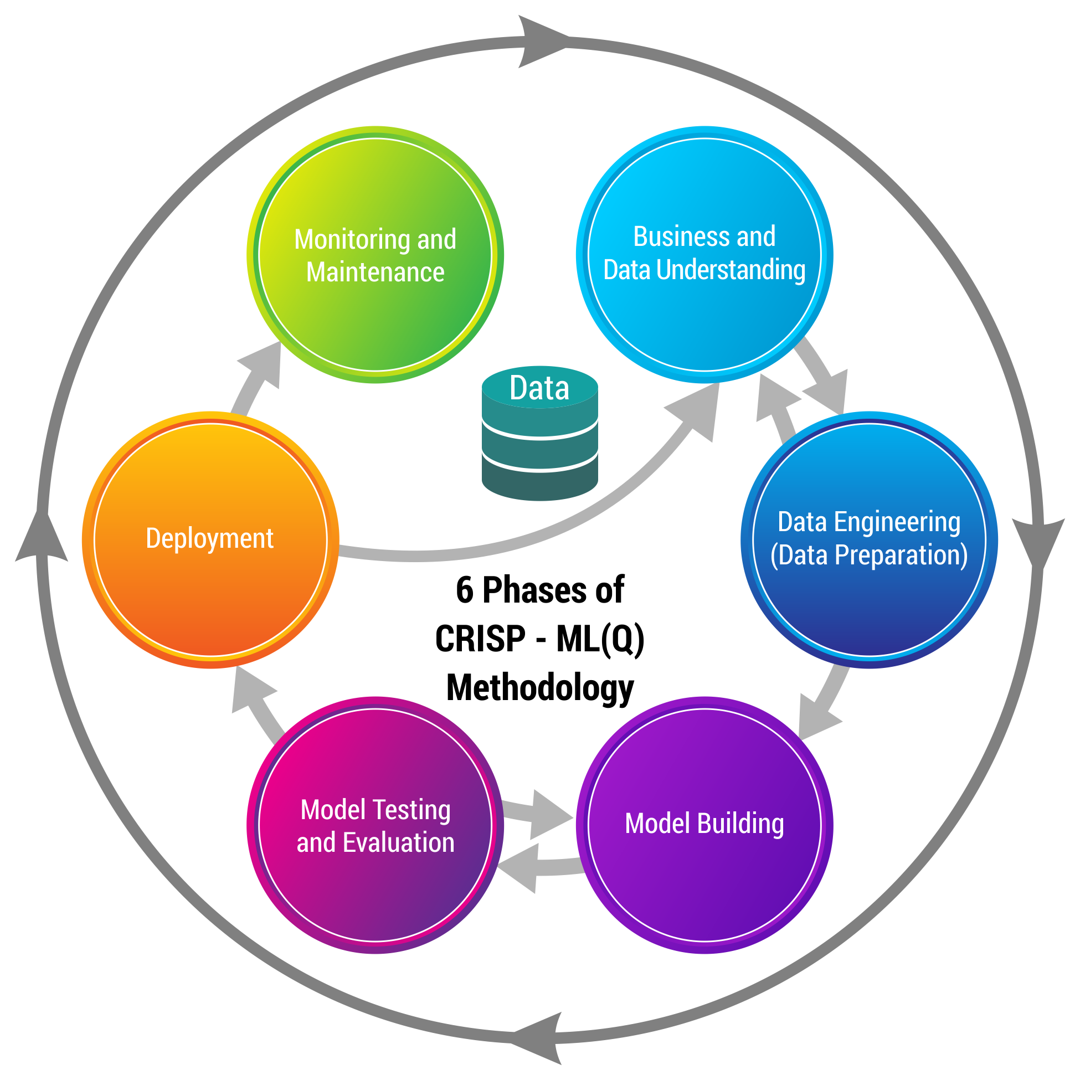
CRISP-ML(Q) Methodology

Slide 8



Technical Stacks
Python is a general-purpose programming language. We used it for Data Cleaning, EDA, Model Building and Visualization.
Language
IDE
Spyder is an integrated development environment (IDE) for scientific programming in the Python language.
Jupyter is Notebook is a web-based interactive computing platform. It is an open-source IDE that is used to create Jupyter documents that can be created and shared with live codes.

Slide 9





Technical Stacks
Libraries
Numpy can be used to perform a wide variety of mathematical operations on arrays.
Pandas is a fast, powerful, flexible and easy to use open source data analysis and manipulation tool, built on top of the Python programming language.
Matplotlib is a comprehensive library for creating static, animated, and interactive visualizations in Python.
Deployment
Streamlit is an open-source python library for creating and sharing web apps for data science & machine learning projects.
GitHub is a code hosting platform for version control and collaboration. It lets you and others work together on Projects from anywhere.

Slide 10

System Requirements
System Requirements
Memory: 8GB RAM
CPU: Intel Core i3 and above
OS: Windows 10 & above
Prepare Environment
Install python version 3.8
Install Anaconda software to launch IDE platform like Spyder and Jupyter
Creating a New Environment
Install Pandas for preprocessing of data
Install Numpy for mathematical calculations
Install Matplotlib for Visualisation
Install Streamlit for Deployment

Slide 11
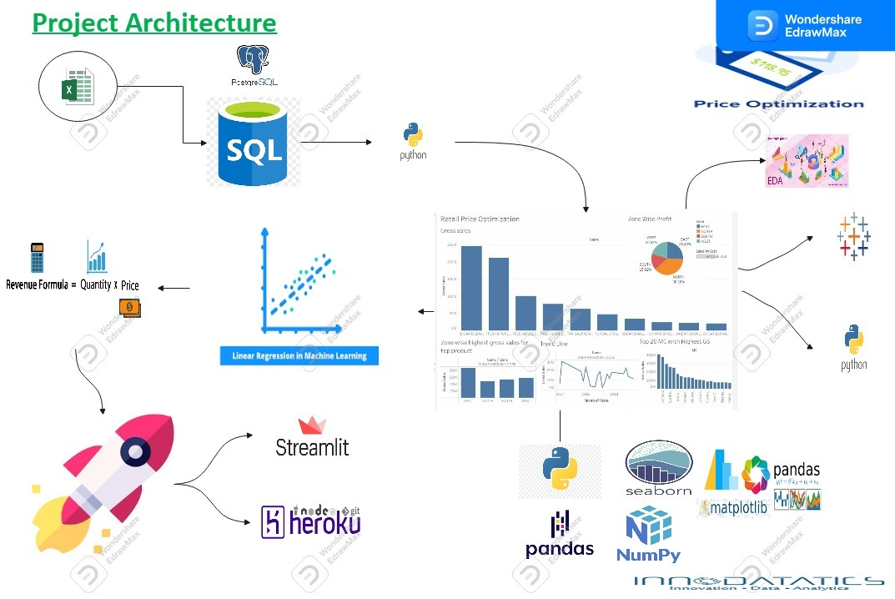
Project Architecture

Slide 12

Data Collection
Data Collection is defined as the procedure of collecting, measuring and analyzing accurate insights for research using standard validation techniques.
The transactional data is recorded from the client on a server. This server is duplicated for study purpose.
Using PostgreSQL, a virtual local server is created in which a database is created. This database has all the records of transaction.
The data consists of 37438 records having 4 zones, 128 material categories and 2312 different products.

Slide 13

Data Understanding
Particulars | Description
UID | Unique ID for a Material
NAME | Name of the Material
ZONE | Name of the zone of Business
Brand | Brand of the material
MC | Material Category: Category of the material
Fdate | Month of Sale
NSU | Net Sale Unit: Total units sold in a month
NSV | Net Sale Value: Total sale value in a month
GST Value | GST Value: GST on the NSV
(NSV-GST) | Calculation only
Sales at Cost | Cost to company

Slide 14
Data Understanding
Particulars | Description
SALES AT COST | Calculation only [(NSV-GST) – Sales at Cost]
MARGIN% | Percentage of Margin
Gross Sales | Gross Sales means the grand total of all sales transactions over a given time period.
Gross RGM(P-L) | Gross Margin
Gross Margin % (Q/P*100) | Gross Margin Percentage
MRP | Maximum Retail Price of unit item
SP | Selling price of unit item
DIS | Discount in Rupees.
DIS% | Discount in Percentage

Slide 15
Data Dictionary
Data contains various features and the shape of the data is 20 columns and 37437 rows.
In this model the data is analyzed considering the below features for the model building.
Data Dictionary
Name of the features | Description | Data Type
NAME | Name of the Material | Nominal
ZONE | Name of the zone of Business | Nominal
NSU | Net Sale Unit: Total units sold in a month | Ratio
SP | Selling price of unit item | Ratio
Sales at cost | Cost to company | Ratio

Slide 16
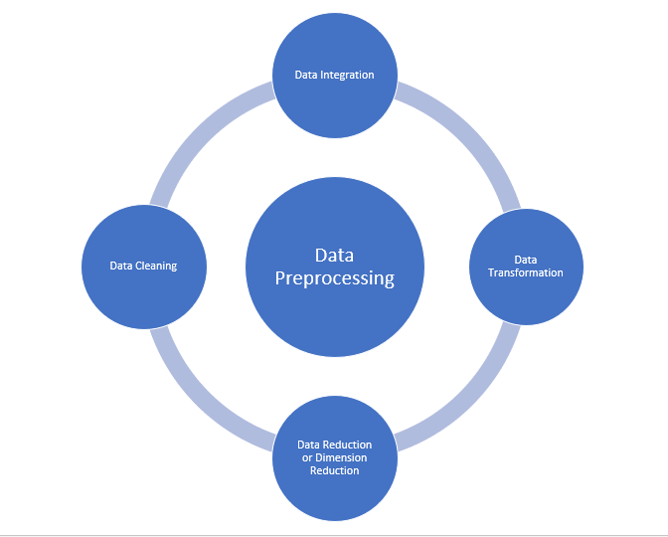
Data Pre-Processing

Slide 17
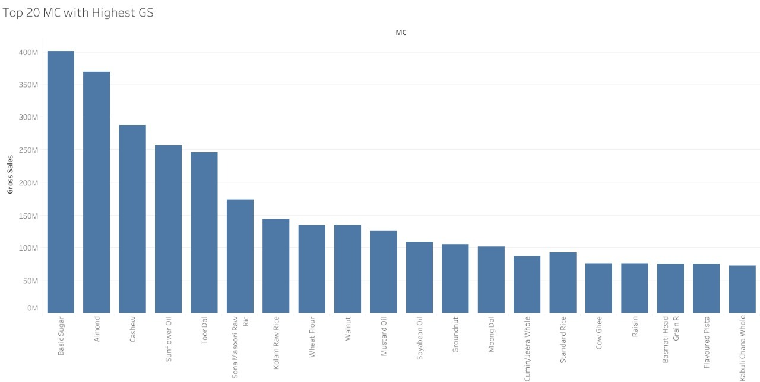
Exploratory Data Analysis:
Top 20 Material categories By Gross Sell

Slide 18
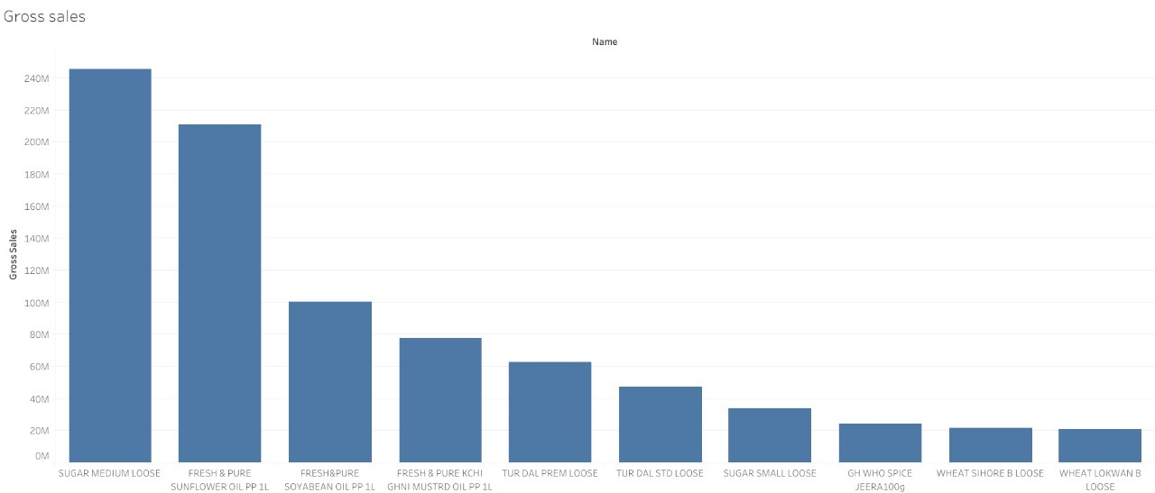
Exploratory Data Analysis:
Top 10 Items By Gross Sell

Slide 19
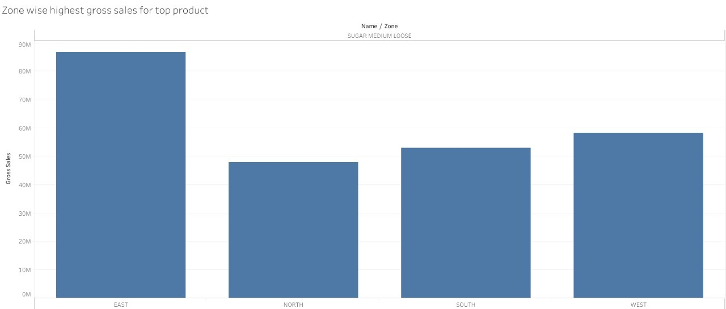
Exploratory Data Analysis:
East Zone has highest Gross Sales
Job Dataset

Slide 20
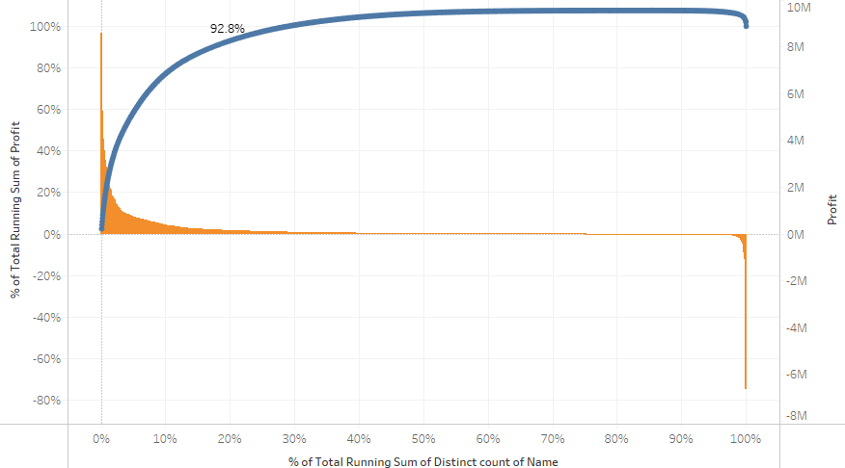
Exploratory Data Analysis:
Up to 20% of the total product contributing to get around 90% of the Total revenue.

Slide 21
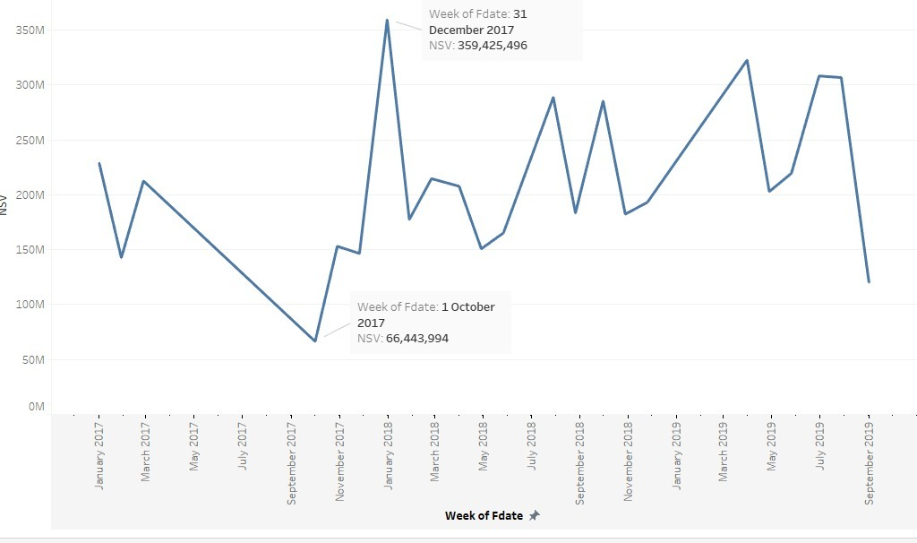
Exploratory Data Analysis:
Sales Over time: Consistently sales is high between the month January/July.

Slide 22
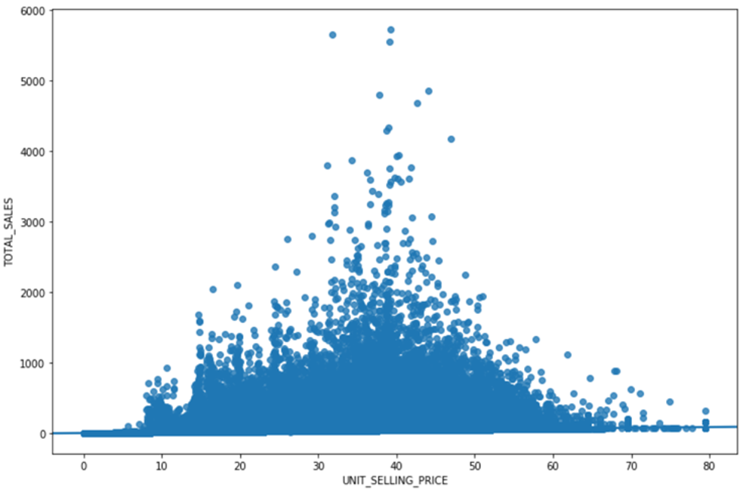
Exploratory Data Analysis:
At Low selling Price Sales is less
After Certain Point, higher selling Price does not result in higher Profit
Above can be used to determine Price Point to optimize profit and revenue

Slide 23
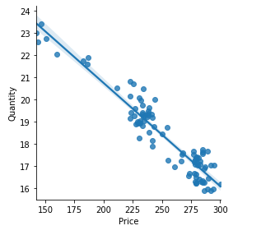
Model Building
Optimize selling price of the Product to maximize profit and sales.
Price elasticity ideally needs data on how customers react to price variation.
A demand curve helps analyze the maximum price at which demand is not impacted.
We will use existing data to draw demand curve to find range of potential sales price to optimize revenue or profit .
Based on the range, existing sales data will be used to predict or estimate the selling price.
.

Slide 24
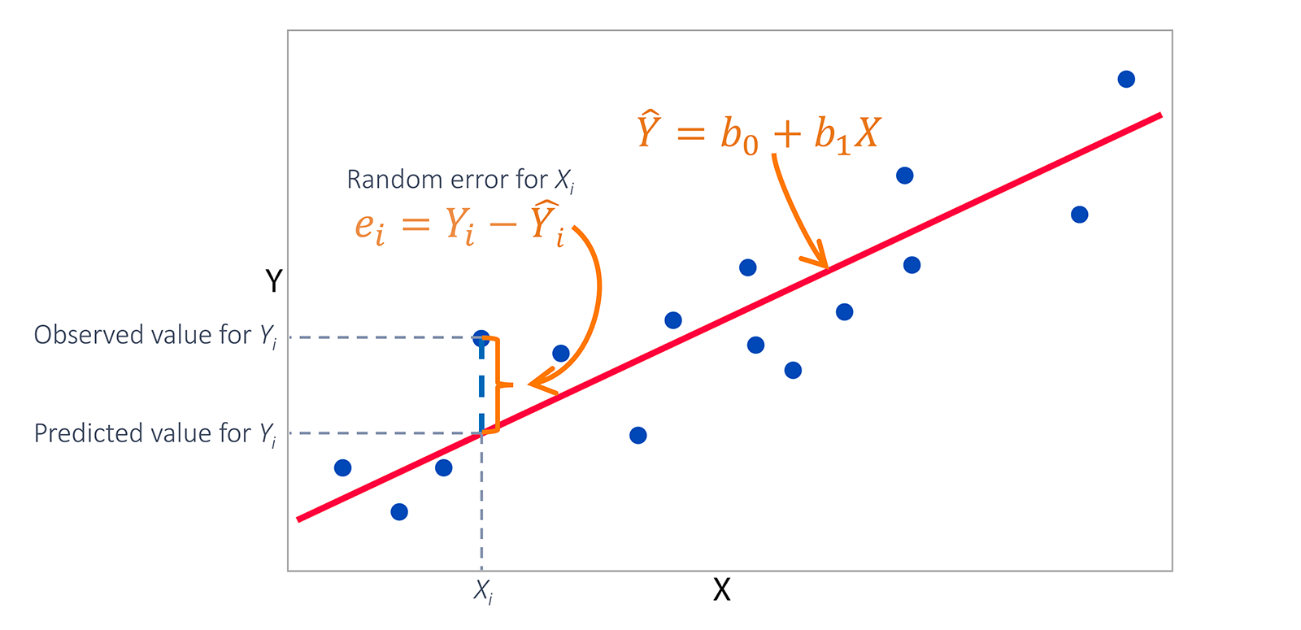
Model Building
Ordinary Least Squares regression (OLS) :
OLS is a common technique for estimating coefficients of linear regression equations which describe the relationship between one or more independent quantitative variables and a dependent variable (simple or multiple linear regression).
The simple linear regression is a model with a single regressor (independent variable) x that has a relationship with a response (dependent or target) y that is a
y = β0 + β1 x + ε
Where
β0: intercept
β1: slope (unknown constant)
ε: random error component
This is a line where y is the dependent variable we want to predict, x is the independent variable, and β0 and β1 are the coefficients that we need to estimate.

Slide 25
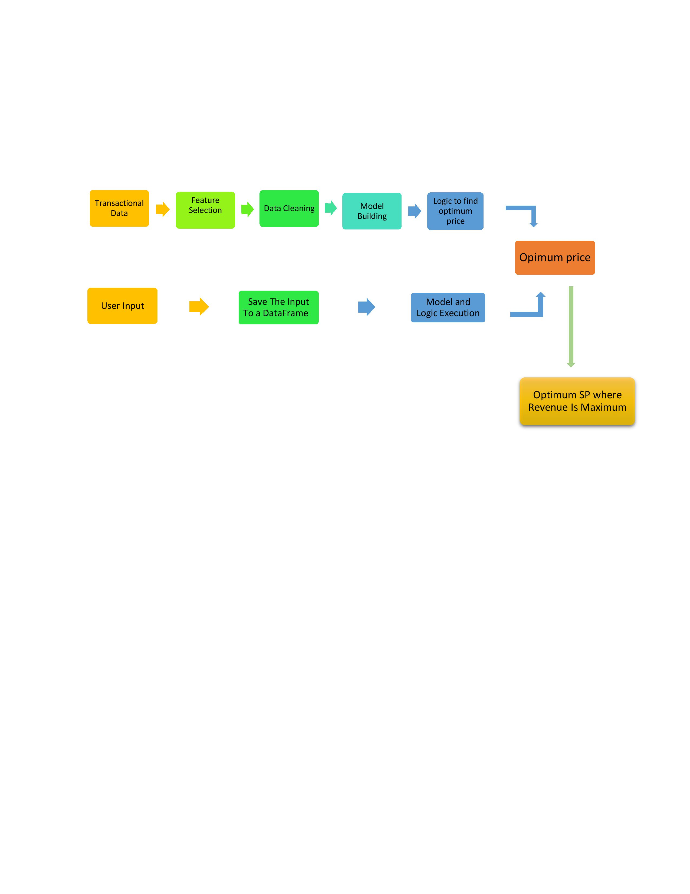
Model Building
Content - Price optimization for maximizing revenue by using Linear regression:
Regression analysis employing the use of historical data is widely used to estimate the effect of changes in price on sales.
Historical data can provide insight as to how sales volume will be affected by changes in price and market variables such as; seasonality, advertising, promotions, competitive product prices and other variables deemed appropriate.
Regression analysis produces a price elasticity measurement that quantify es the price sensitivity of consumers with respect to the observed product
Fig : Model Building Process

Slide 26
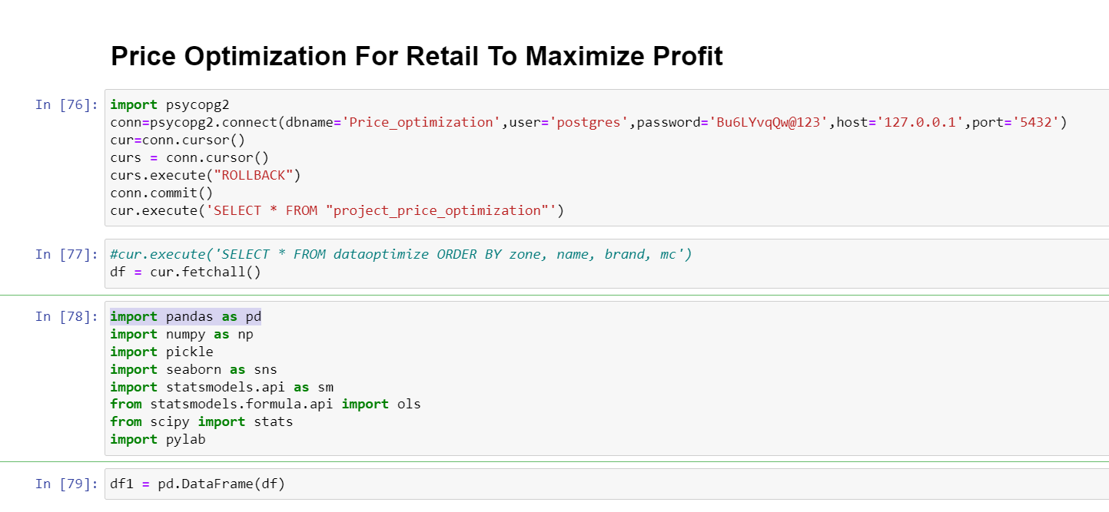
Model Building

Slide 27
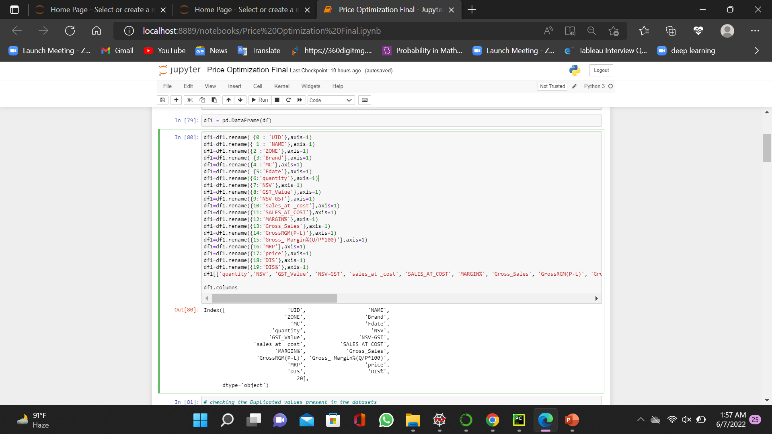
Model Building

Slide 28
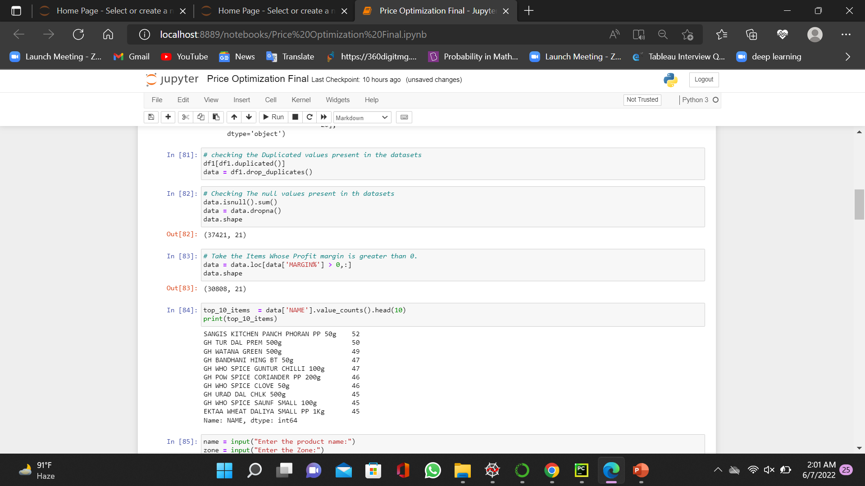
Model Building

Slide 29
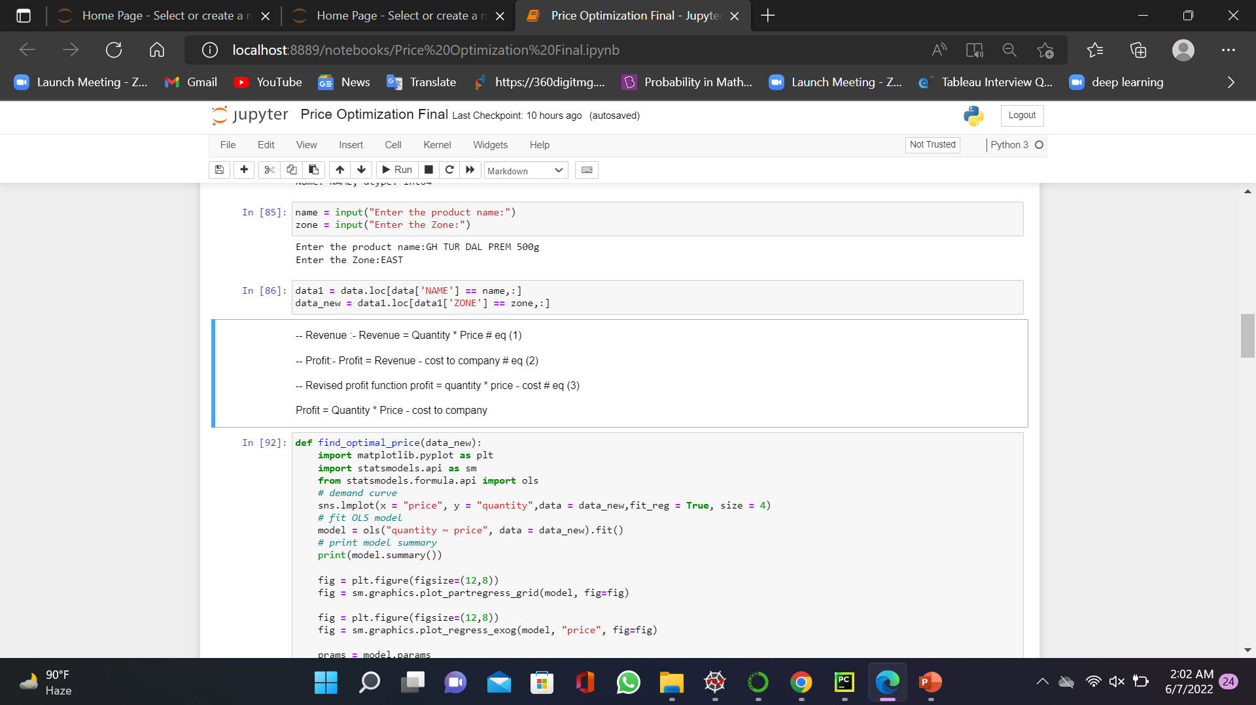
Model Building

Slide 30
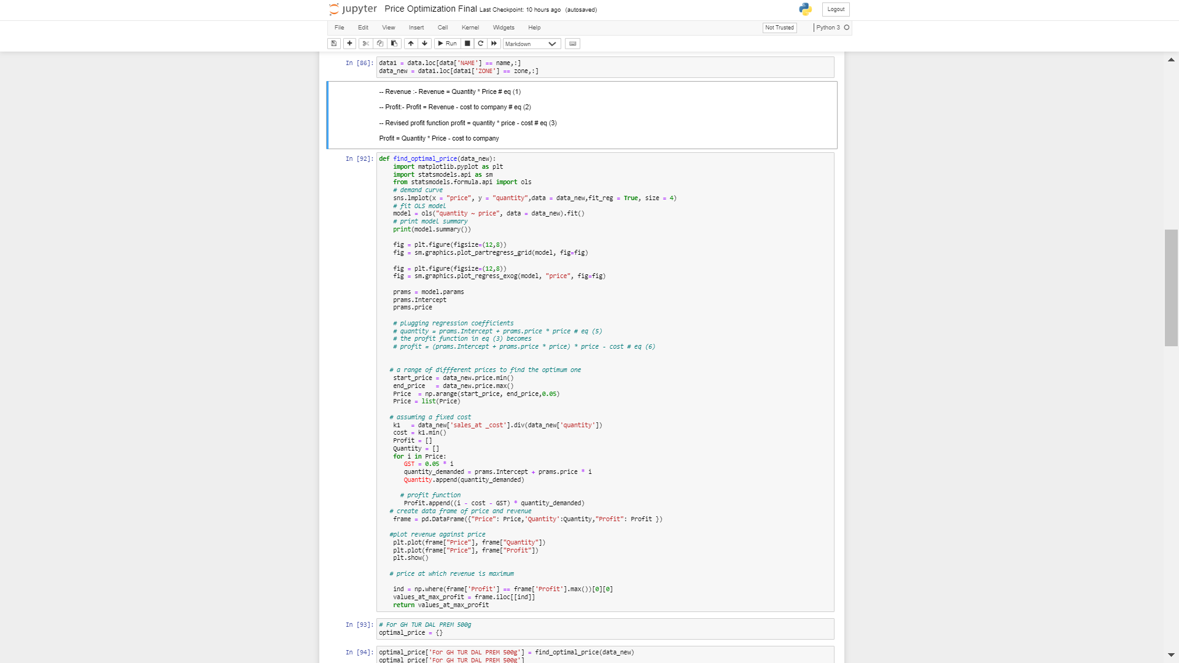
Model Building (Price Optimization For Retail To maximize Profit)

Slide 31
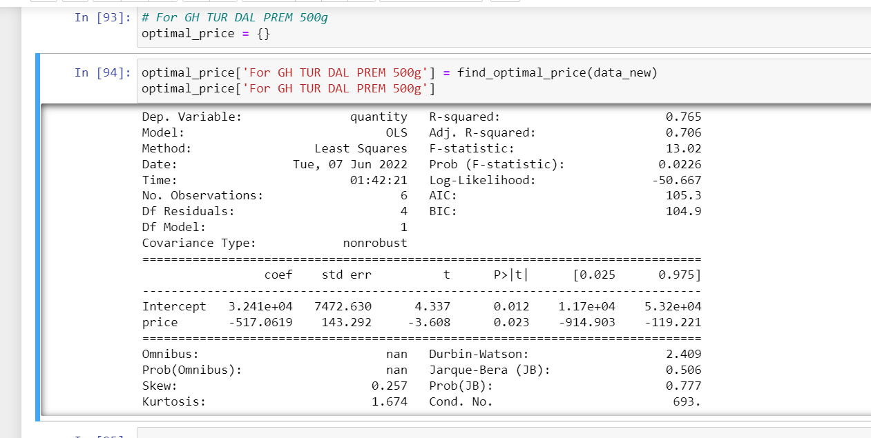
Model Building
Model Summary for Popular product GH TUR DAL PREM 500g :
R – square value is 0.748, some c is explained.
P – Values are less than 0.05 for both the features.

Slide 32
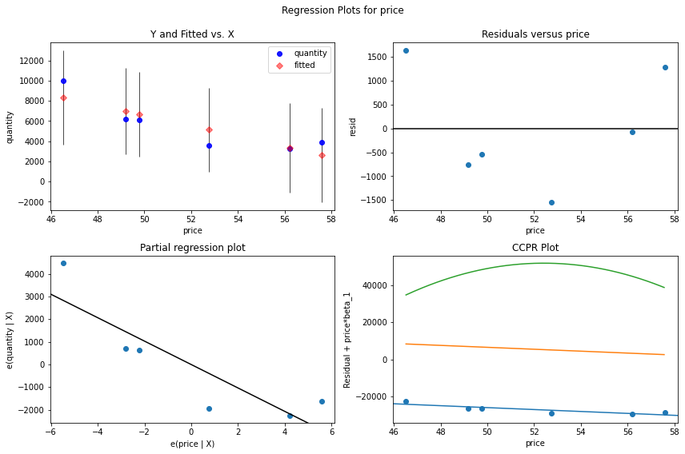
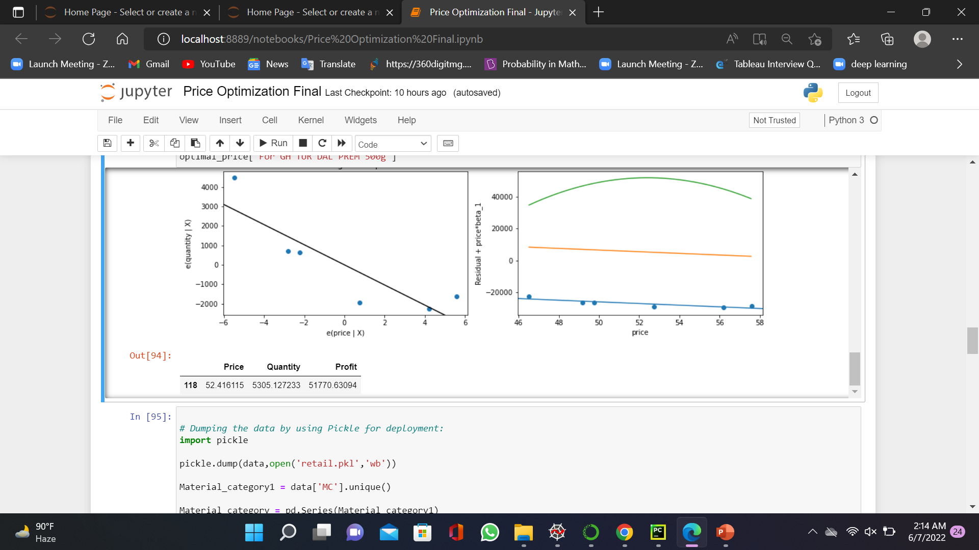
Model Building
Partial Regression Plot for Popular product GH TUR DAL PREM 500g :

Slide 33
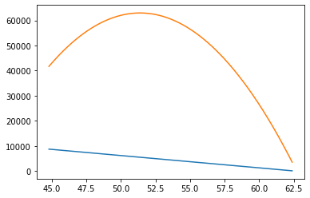
Model Building
Demand Curve for Popular product GH TUR DAL PREM 500g :
Demand peak is when selling price is between 49 to 55. above 55 people are resisting to buy it
If price and revenue are plotted, we can visually identify the peak of the revenue and find the price that makes the revenue at the highest point on the curve.
So we find that the maximum revenue at different price levels is reached at 550000 when the price is set at 89.

Slide 34
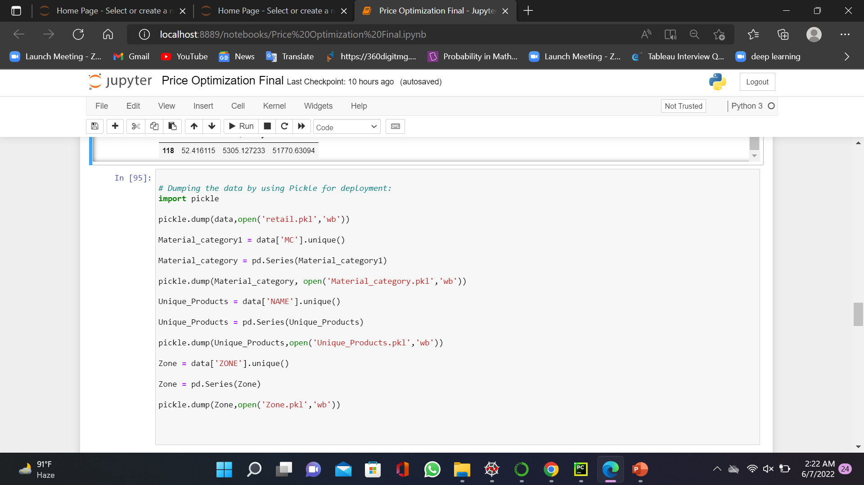
Model Building (Price Optimization For Retail To maximize Profit)

Slide 35
Model Deployment
Web based deployment was used to deploy code from source control to hosting platform
Streamlit library was used for app deployment
Streamlit integrates with GitHub to make it easy to deploy code living on GitHub to apps running on Streamlit
Pickle the required files (dataset,vector and model)
Create a GitHub repository containing all the required files (pickled files,installation requirements,text files) etc
Create an app in Streamlit and connect it to the GitHub repository

Slide 36
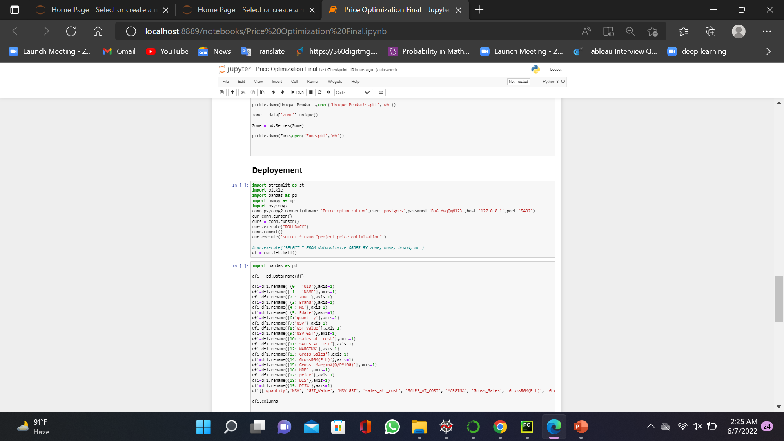
Model Deployment

Slide 37
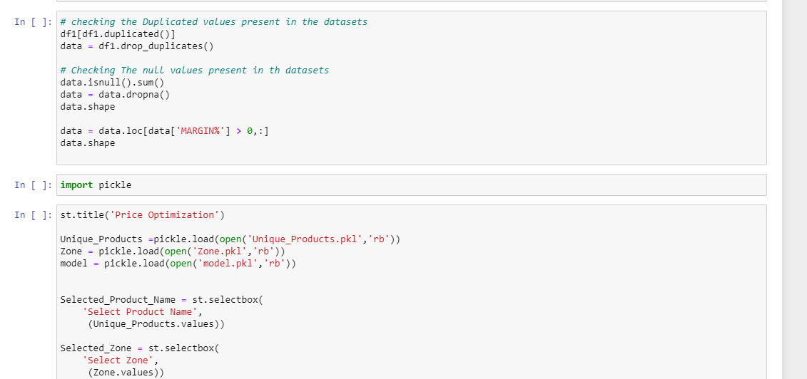
Model Deployment

Slide 38
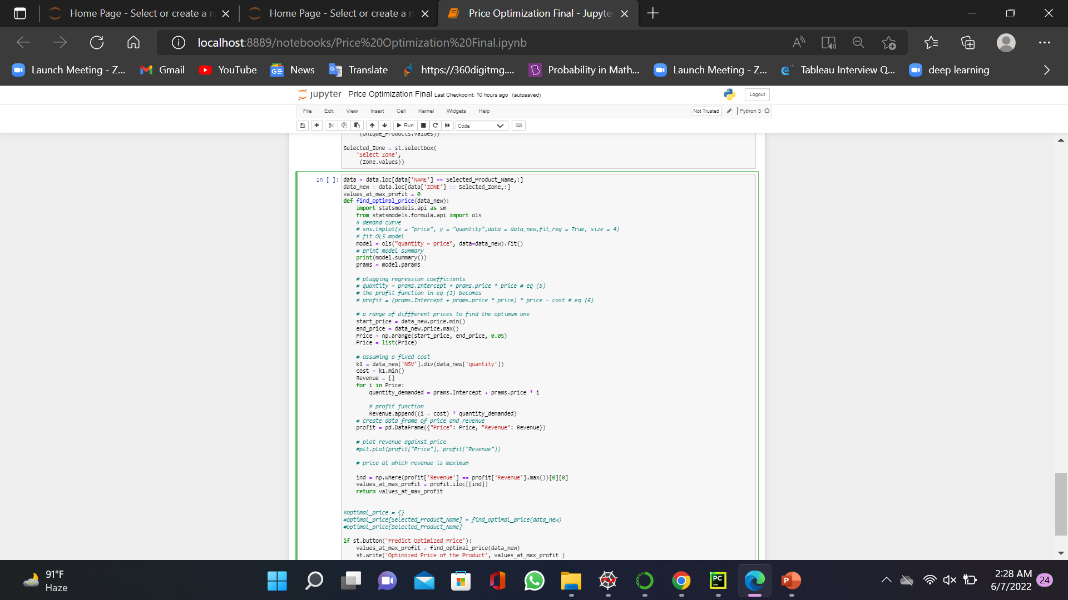
Model Deployment

Slide 39
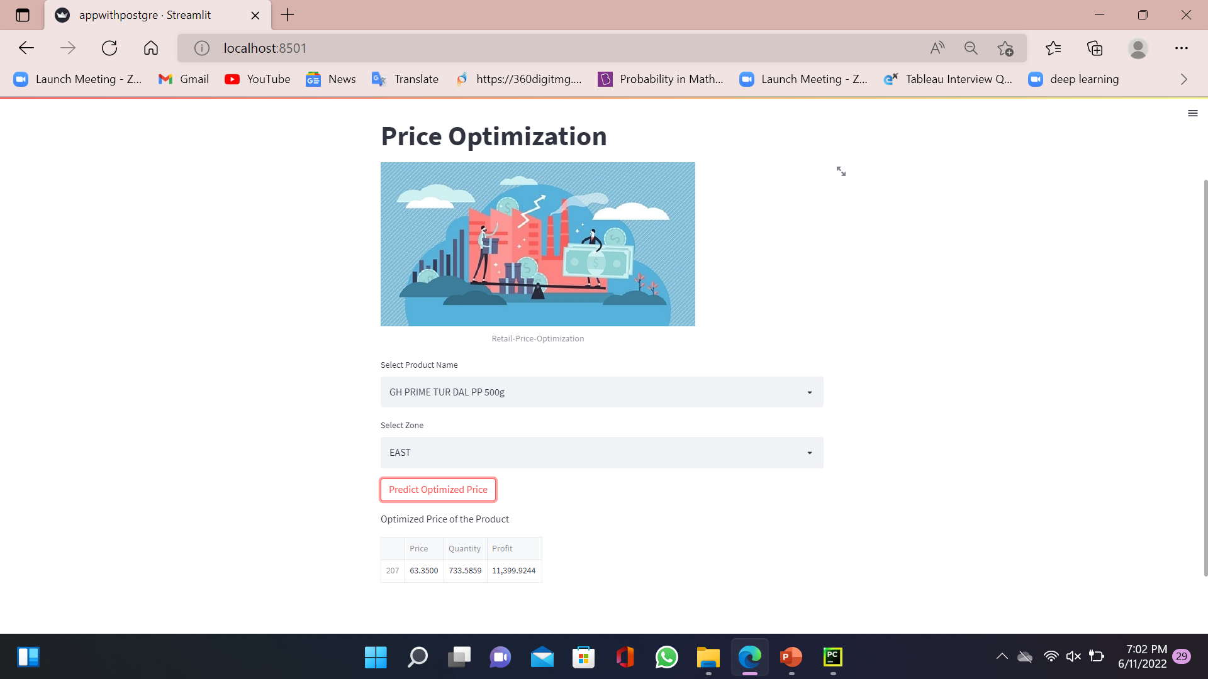
Model Deployment Output

Slide 40
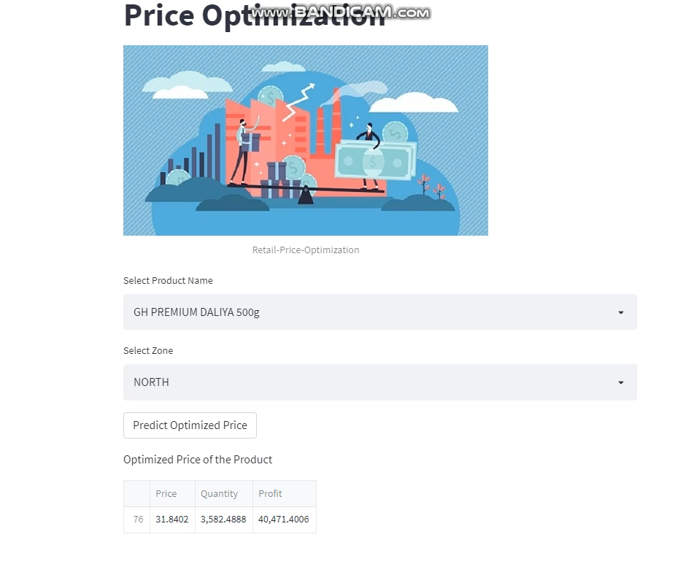
Model Deployment Output

Slide 41

Challenges
Less data for different products
Dealing with missing values and outlier treatment
Research on various price optimization techniques

Slide 42

Further Scope
Customer Behavior Analytics :
Obtain Customer data and categories customers into regular, semiregular and infrequent. Use analytics and machine learning models to understanding purchase behaviors of this users and adjust price and discounts accordingly.
Dynamic Pricing :
Pricing can further be optimized by regularly adjusting the selling price
(even on daily basis) by inputting the variables.

Slide 43
References
https://www.vendavo.com/c-suite/importance-price-optimization/
https://dlabs.ai/blog/price-prediction-how-machine-learning-can-help-you-grow-your-sales/
https://competera.net/resources/articles/machine-learning-pricing-optimization
https://competera.net/resources/articles/dynamic-pricing-engine
https://competera.net/resources/articles/dynamic-pricing-algorithm
https://vitalflux.com/pricing-optimization-machine-learning-techniques/
https://towardsdatascience.com/mercari-price-suggestion-97ff15840dbd
https://blog.hubspot.com/sales/price-optimization
https://tryolabs.com/blog/2020/06/01/price-optimization-for-e-commerce-a-case-study

Slide 44

Queries ?

Slide 45

Thank you for your
Time & Consideration!

